Slide 1
Document Imaging Web Application
Developed using ASP.NET, GdPictures 14
By Trupti Dalia (ID: 874468) Summer 2017

Slide 2
About
Document Imaging Web Application
Document Imaging application is specially designed based on the requirements of Daytona State College IT Department.
User can open and/or scan a file, manipulate it with various features, Print and/or Save the file as a PDF and/or Tiff file. Currently supported files that can be opened are PDF, Docx, Image, Txt file. For ease of usage, user can either Drag N Drop file or Browse the file to open it.
Application can also be used to read files; access any page of the file by entering page number or clicking Previous/Next, remove any page from existing file or scanned files.
Zoom contents of the file, Rotate any page and the page will be saved in the selected Rotation form
Add Signature, Timestamp, “Approved”, “Rejected” stamp in your preferred location and format.
Documents received as image usually are not clean. Clean such document images by getting rid of black borders, black marks, punch hole marks, straighten the image.

Slide 3
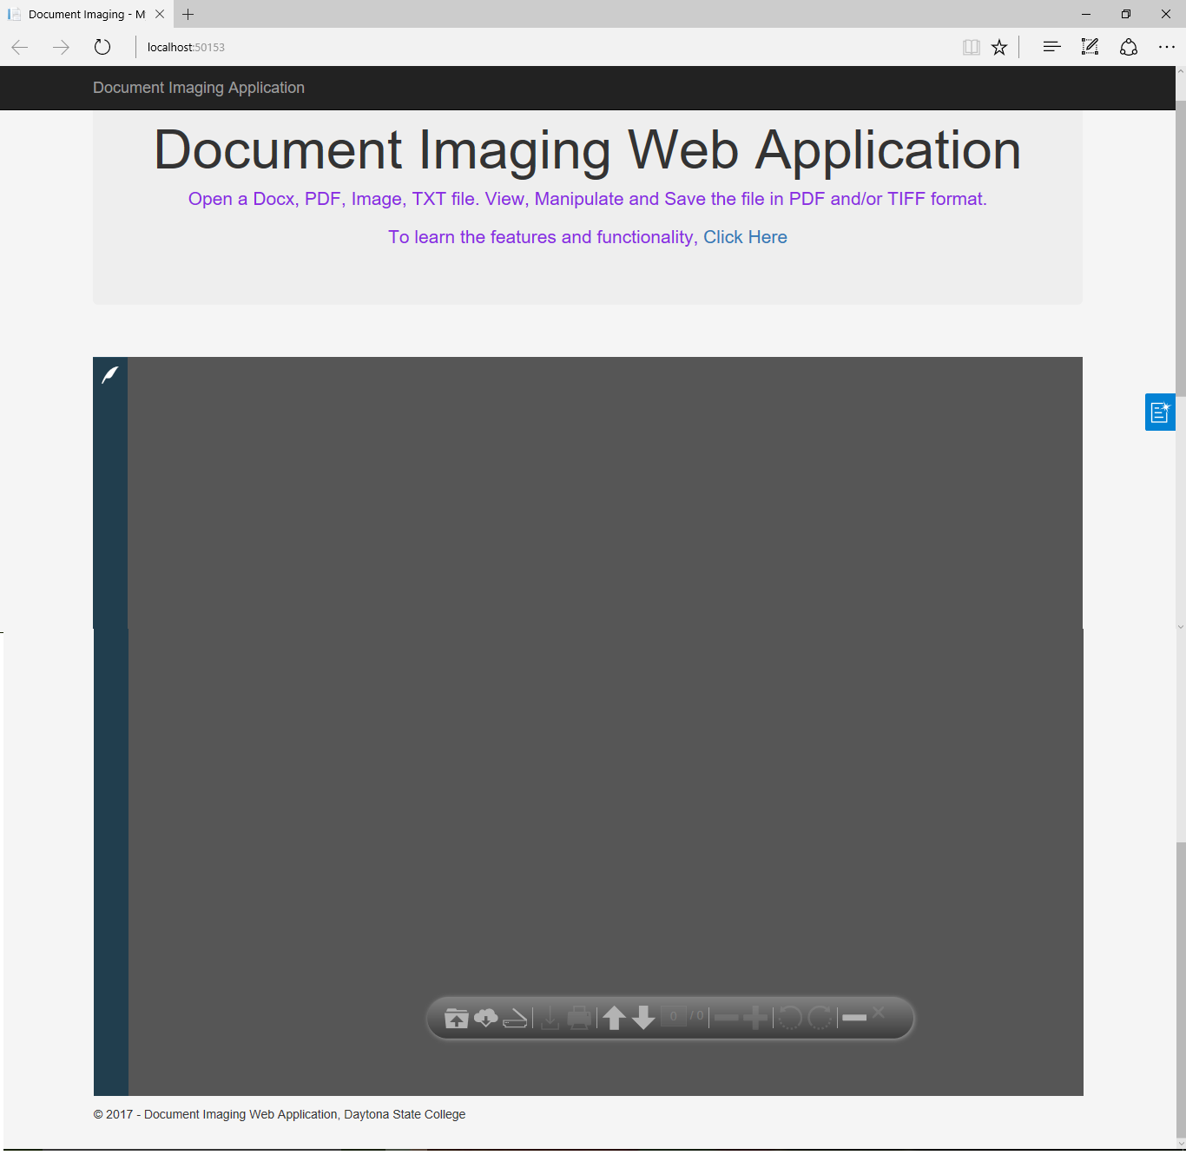
Start of the application

Slide 4
Open File by Browsing
and select the File to
open.
Click on “Load from URI”
and open file from the
cloud.
Easily Close any opened
file by clicking
“Close Doc”
Open
Load from URI
Close Document

Slide 5
Drag N Drop

Slide 6
Thumbnails shows list of pages in the current file.
Comments menu lets user add comments for current page.
Leave Request Approval menu lets add TimeStamp, Signature, Approved and Rejected Stamp.
Operations menu handles Cleaning the image features like Remove black borders,
Punch holes, Black marks, Straighten the image.

Slide 7
Pagination and Page Numbers
Enter any pae number and view the contents of that particular page. This feature turns very efficient when the file is huge with several pages.

Slide 8
Save File as PDF / TIFF
Save the Docx file to PDF file. See the downloaded file on Save.

Slide 9
Delete a Page from File
After Deleting
Page # 3, the page
is no more visible
in the Thumbnails
and the number of
pages are only 3
instead of 4.
This tells that the
page has been
deleted sucessfully.

Slide 10
Rotation and Zooming
Effect of Rotating Page # 1 reflected on Thumbnails and the
page itself.
Zoom the contents of the fille for better viewing.

Slide 11
Annotations
Add Time Stamp. Can move around to place accordingly.
Approved and Rejected Stamp. The default text and design can be changed as per user's preference.
Add Signature. Signature can als obe formatted by adding image, text, formatting background, fore color, text style, border and so on.

Slide 12
Print, Scan File
Scan documents through Scanner and get file loaded. All operations can be operated on a Scanned document too.
Print the current loaded file to desired
Printer.

Slide 13
Clean-up Image Operations
Auto Deskew -
Straighten an image
Despeckle - Remove Black dots,
Punch marks, Black borders

Slide 14
Document Imaging Application
Developing such “Document Imaging Application” with so many features in a single web application was great fun and challenging too.
Hosting the application on Web, makes it more easy and convinient for users to use without the hassle of installation and/or updations.
It was pleasure working on this application. I hope users also find it helpful and pleasureable to use.
Thanks,
Trupti (ID: 874468)

